Slide 1
Lyrically Sound
September 23, 2020
James Nicholson & Andrea Hayward

Slide 2
Elevator Pitch

Slide 3
Concept
Lyrically Sound is an application that utilizes API calls to provide search results in live time for end users searching on musicians.
Music is huge part of almost everyone’s daily lives. With many people spending hours per day on a computer, we wanted to create an application for users to easily search for top hits by their favorite artists.
USER STORY: AS A user I WANT to be able to search on an artist SO THAT I can see their top 5 songs returned to me and, SO THEN I can choose a song I want to listen to.

Slide 4
Process
Technologies used:
Foundation Framework for HTML styling
Deezer API for live time music search results
Breakdown of tasks and roles
HTML/CSS Styling – James Nicholson
Javascript API Calls – James Nicholson, Andrea Hayward
Merging HTML and Javascript – James Nicholson, Andrea Hayward
Challenges
Merging classes/IDs between the HTML and JS was a challenge
API – the first few APIs we selected to use returned permissions/authentication errors so it took us a few attempts to find an API we could work with.
Successes
API – finally making a dynamic URL to call on for the API
Search Results – getting the user search history and search results to display on the screen
Foundation – learning a new CSS application and having it correctly display on our page

Slide 5
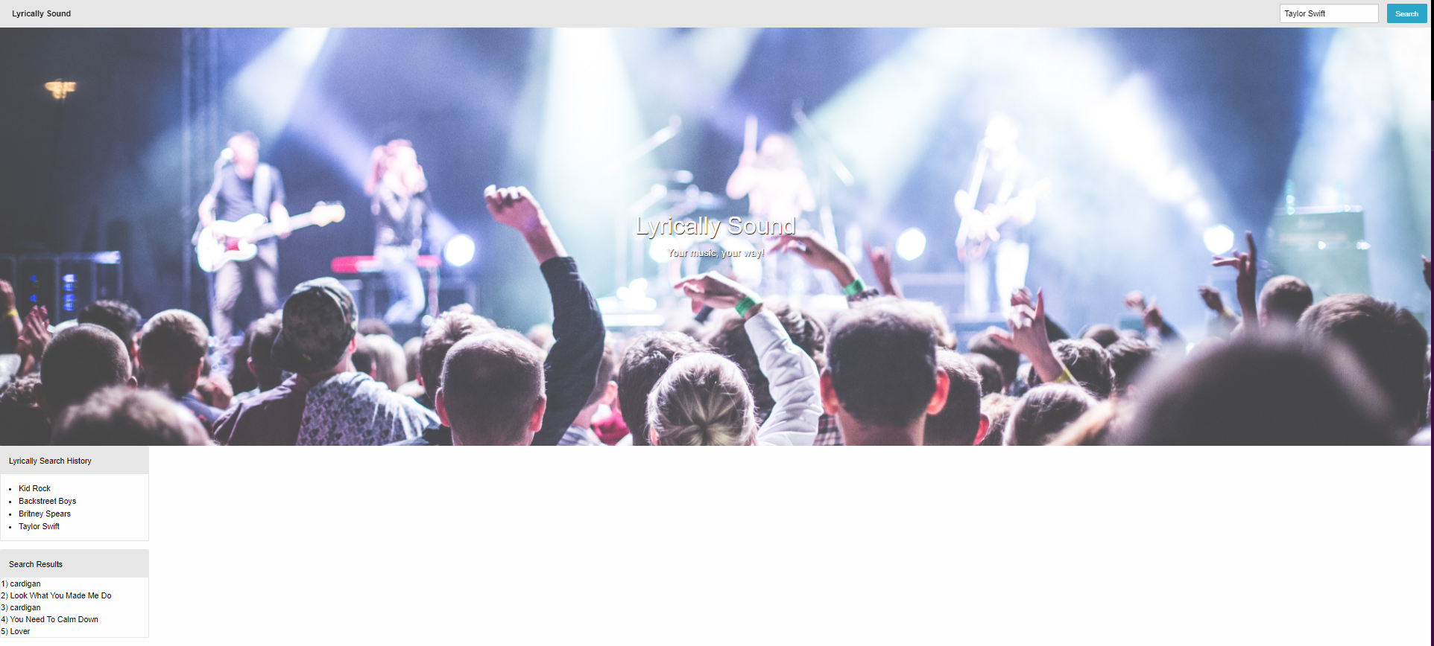
Demo – Coming Soon!

Slide 6
Directions for Future Development
Adding in a music/media player so that users have the option to play/listen to the songs that appear to them in the search results
Calling on an API to return song lyrics
Adding in an API so that users can view an image of the artist they searched on
Adding in an API so that users can see upcoming local events for the artist they searched on

Slide 7
Production Links
Deployed - https://andreahayward.github.io/LyricallySound/
GitHub Repository - https://github.com/andreahayward/LyricallySound

